Slide 1
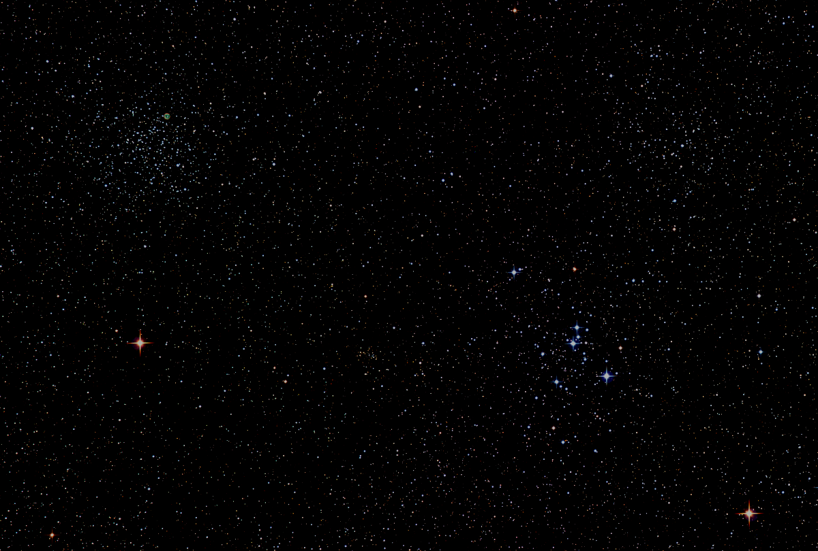

Howard
Astronomical
League
17
June 21st, 2018
Notes:
Howard Astronomical League, June 21, 2018

Slide 2
Introductions

Slide 3
Observatory Report Director: Joel Goodman
1st Public Star Party/reveal on June 16th
Plan
Continue with improvements:
Improve polar alignment with Tpoint
Complete dome controller installation
Identify and acquire eyepieces and accessories
Train current CTO/A cadre on the Illig Scope in order to finish out this year’s star party season
Make observatory accessible for member use
Get new CTOs into the training pipeline

Slide 4
Photos from the Observatory
Caveat: Photos taken just 13 days after the Watson was removed from the pier. Lots of work ongoing and remaining to get the right sensor(s)/accessories working with the Illig scope in its new public outreach role.

Slide 5
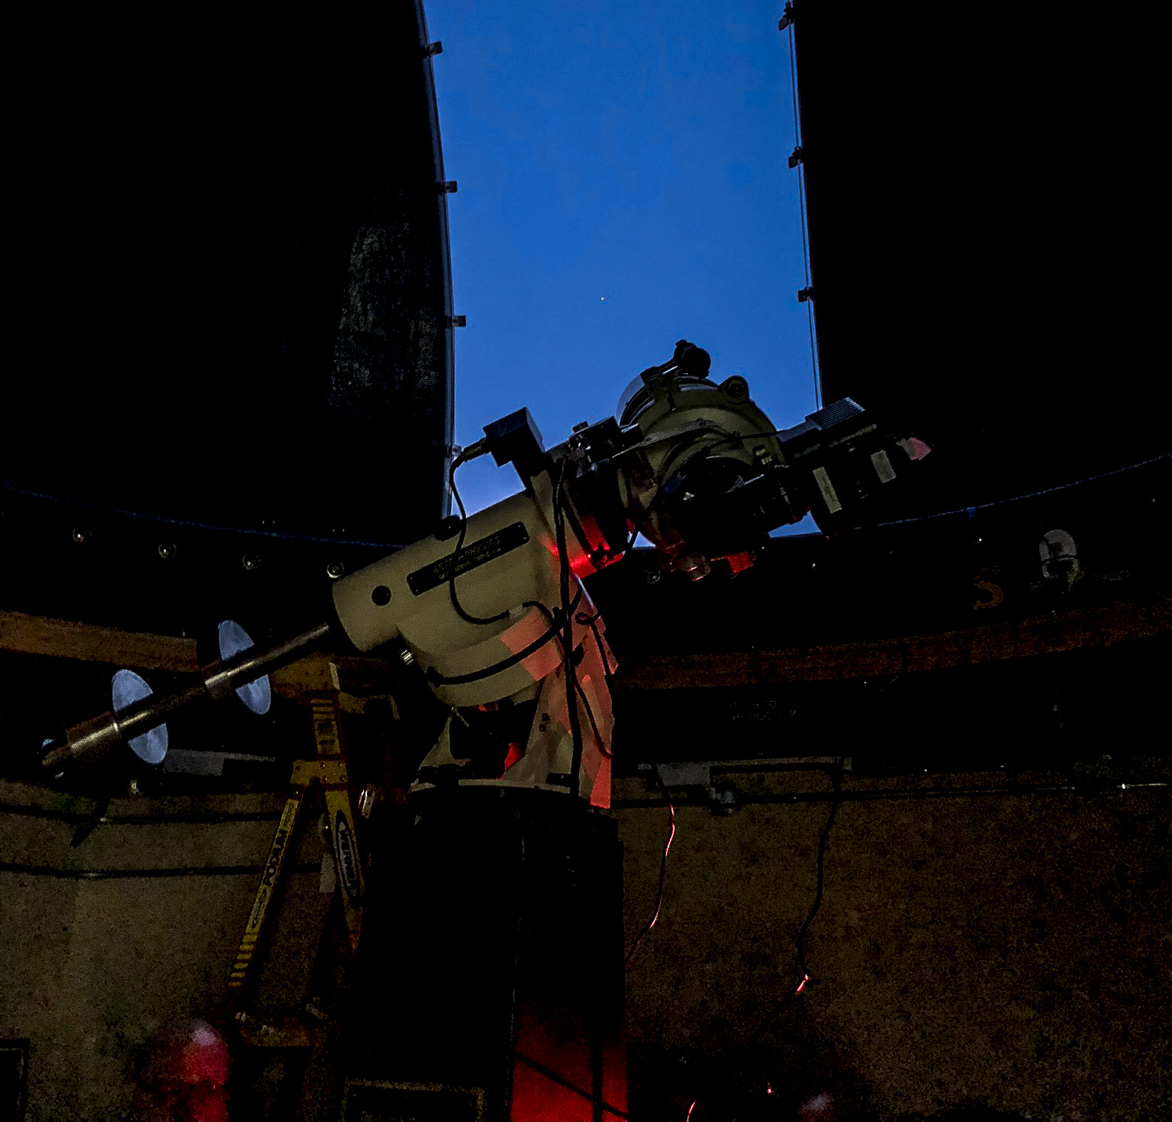
The Illig Telescope Acquires Jupiter
HAL Public Star Party at Alpha Ridge at 8:55pm on 6/16/2018
Phil Whitebloom

Slide 6
Jupiter, GRS and Io Transit/Shadow
June 16, 2018
Capture and Stack by Mike Krauss

Slide 7
Jupiter, GRS and Io Transit/Shadow
June 16, 2018
Capture and Stack by Mike Krauss

Slide 8
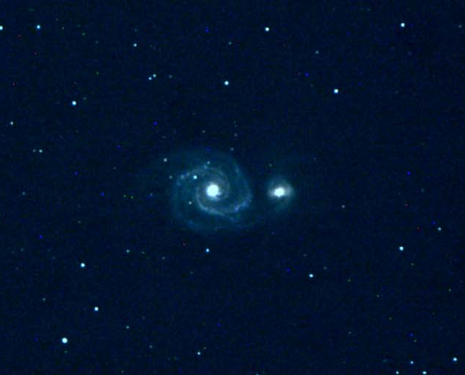
Whirlpool Galaxy (M51)
June 16, 2018
Chas Rimpo and David Stein

Slide 9
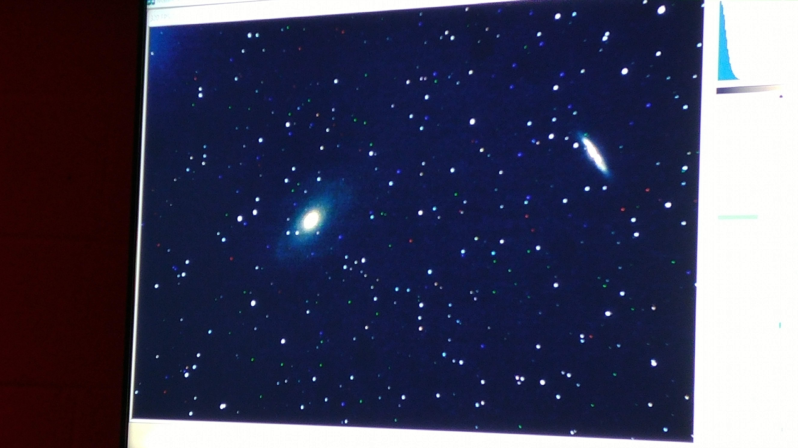
M81 and M82
Smartphone snapshot of the flat panel display
June 16, 2018
David Stein

Slide 10
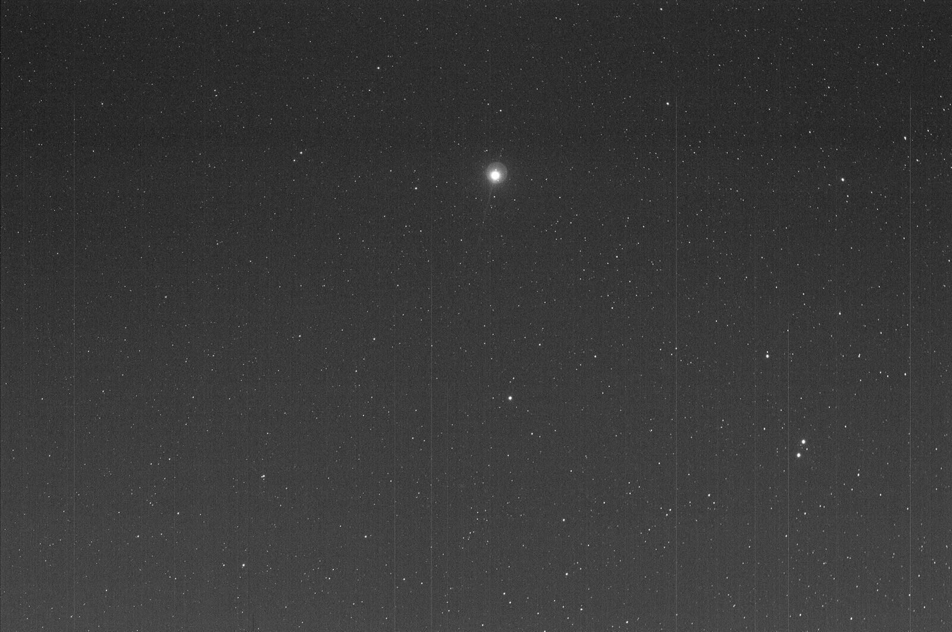
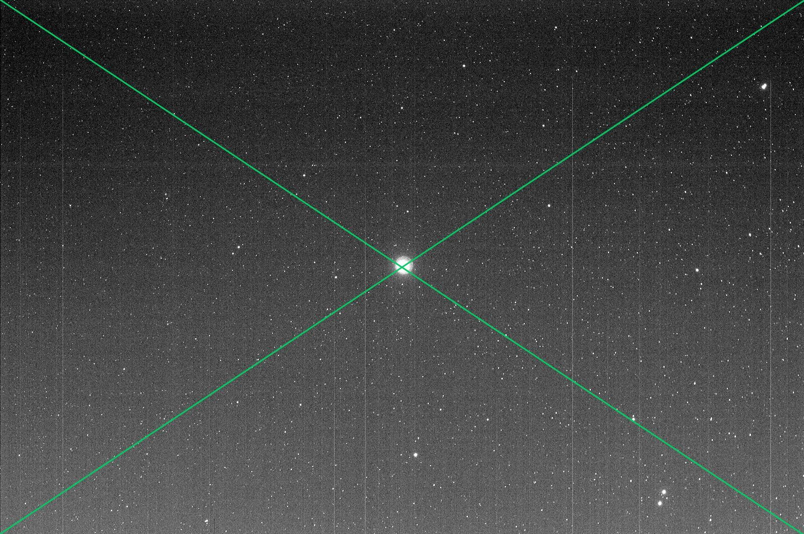
The Illig Scope will get a Tpoint alignment. Here’s an example of how goto accuracy to Vega improved for David Illig’s new mount after Tpoint alignment.

Slide 11
Upcoming Events
HAL Events – Alpha Ridge Park
July 7th at 8:30 – Members Star Party
July 14th 6:30 to 9:30pm – SolarFest
Registration with Rec & Parks Required
July 21st at 8:30 – Public Star Party
Other Events
July 11th to 15th – York County, PA Star Party
July 11th to 14th – Greenbank, WV Starquest XIV

Slide 12
Three Oppositions in 79 Days!
Jupiter: May 8th
Saturn: June 27th
Mars: July 27th

Slide 13
Venus
15 Aug – Dichotomy (Half phase)
17 Aug – Greatest elongation east
25 Sep – Greatest brightness
26 Oct – Inferior solar conjunction

Slide 14
This Evening’s Speaker
Richard Orr
HAL Member
Tips on Observing Mars During the 2018 Opposition
Notes:
It is my distinct pleasure to introduce Dr. Bindu Rani. She has been a Postdoctoral Fellow at NASA/Goddard Space Flight Center since July 2016, and will continue to hold that post until June 2019. She was also a Postdoctoral Fellow at the Max-Planck-Institut für Radioastronomie Bonn, Germany from February 2014 to June 2016. She has held visiting scientist and researcher positions at the Korean Very Long Baseline Interferometry Network of the Korea Astronomy and Space Science Institute, and The Gra-dig-nan Bordeaux Nuclear Research Center in France. Dr. Rani has experience in Gamma-ray, X-ray, optical, and radio astronomy. Her optical observational experience includes use of the 1.04 meter telescope at AIRES, Na-in-i-tal, India, and the 1.20 meter telescope at Mount Abu, India.
Among her many achievements, Dr. Rani was awarded the Otto Hahn Medal for outstanding scientific achievements by the Max Planck Society in 2015. She holds Bachelor and Master of Science degrees from University of Delhi and Da-yan-and University, respectively, in India. Last, and certainly not least, Dr. Rani completed her Ph.D at Max-Planck-Institut für Radioastronomie and University of Köln, both in Germany in 2013.

Slide 15
Member Astrophotos and Sketches

Slide 16
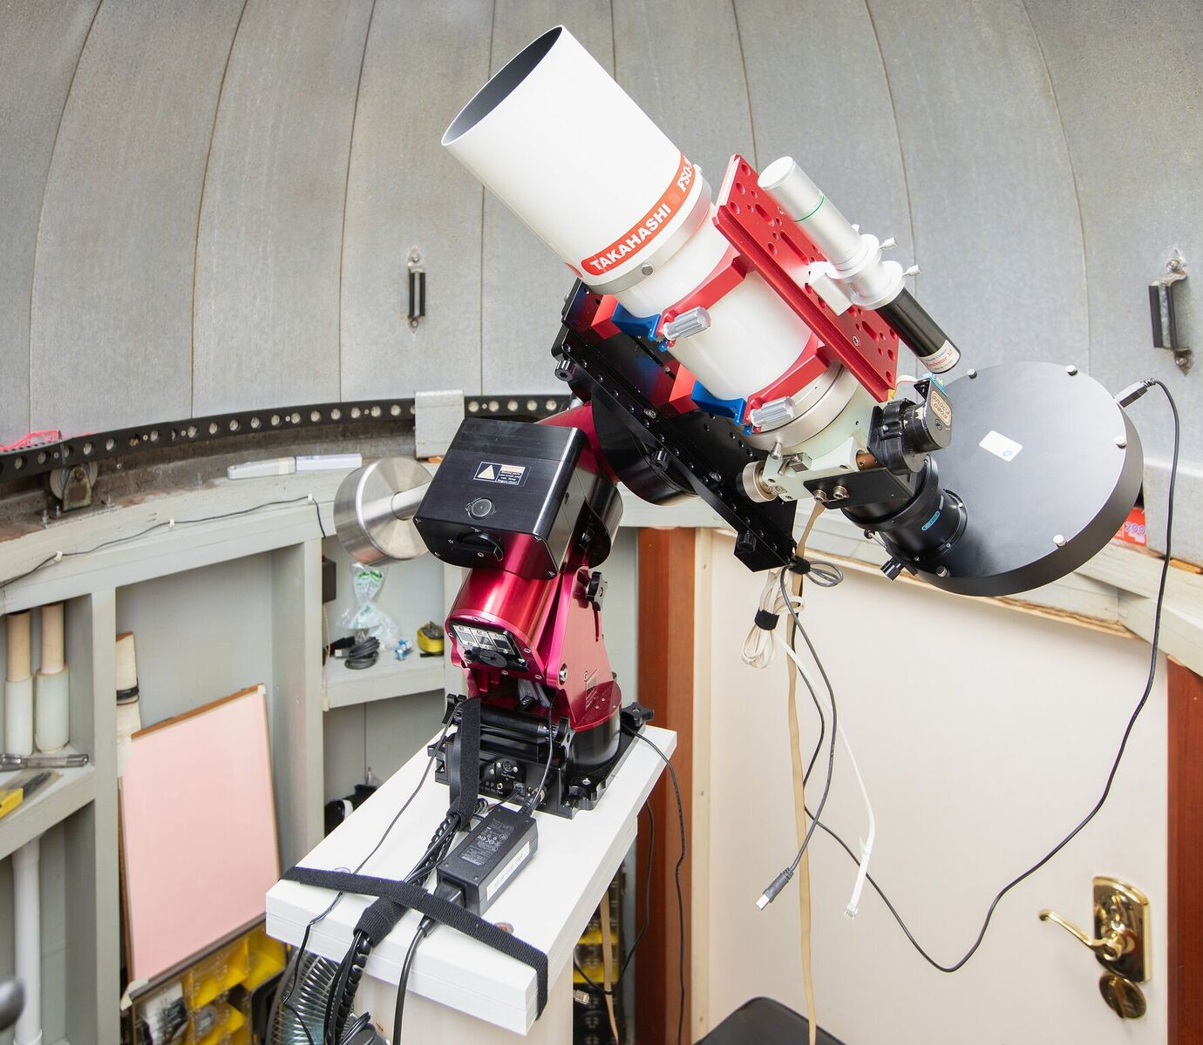
David Illig’s TSO-106 on its new mount

Slide 17
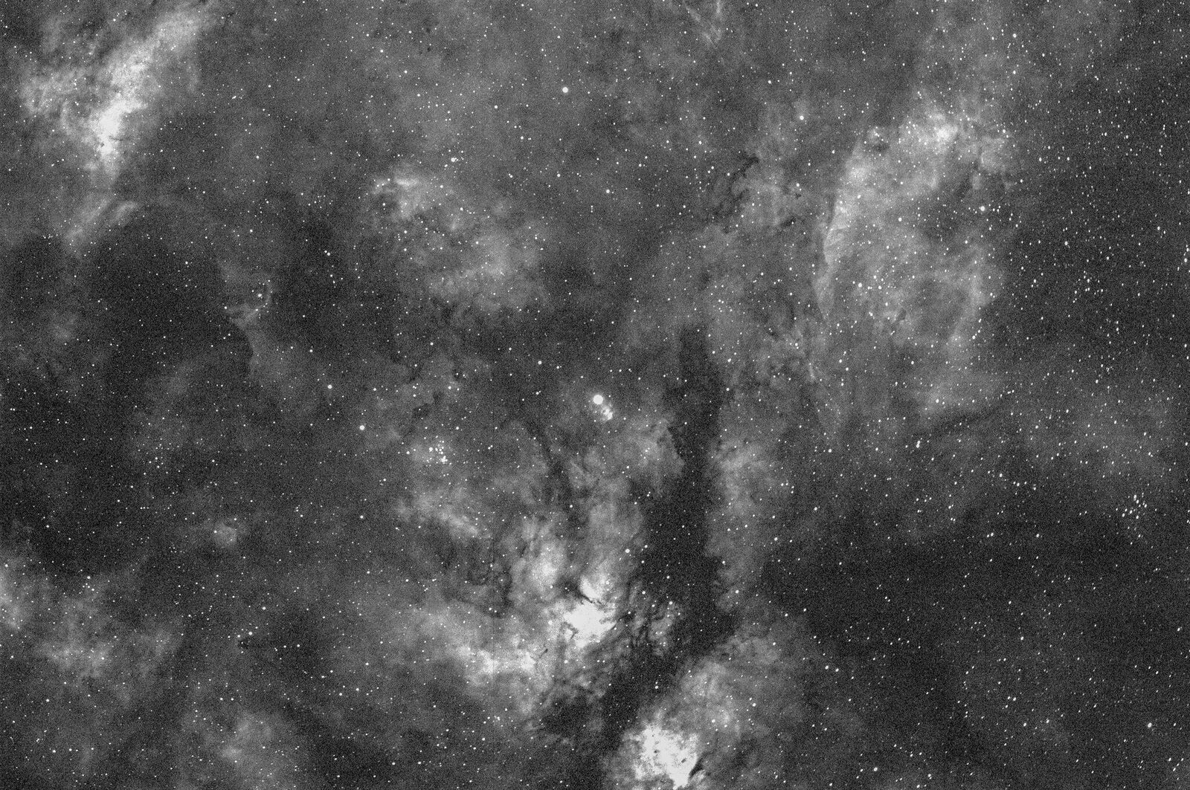
Sadr 21
David Illig

Slide 18
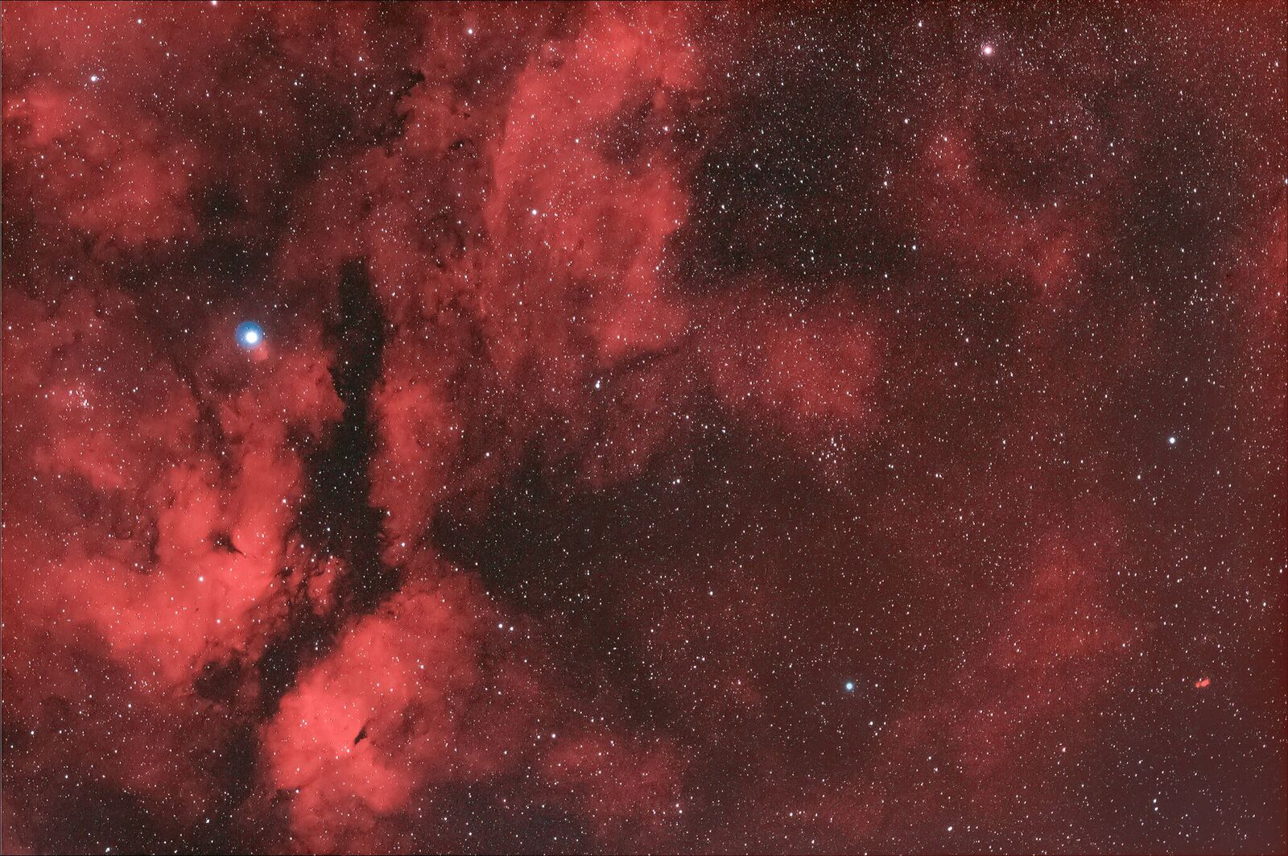
M29 Sadr 21 in RGB
David Illig

Slide 19
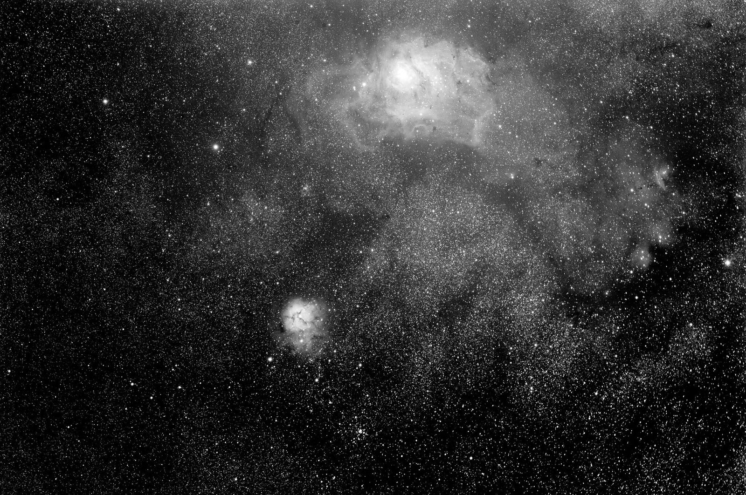
M8, M20, and M21
David Illig

Slide 20
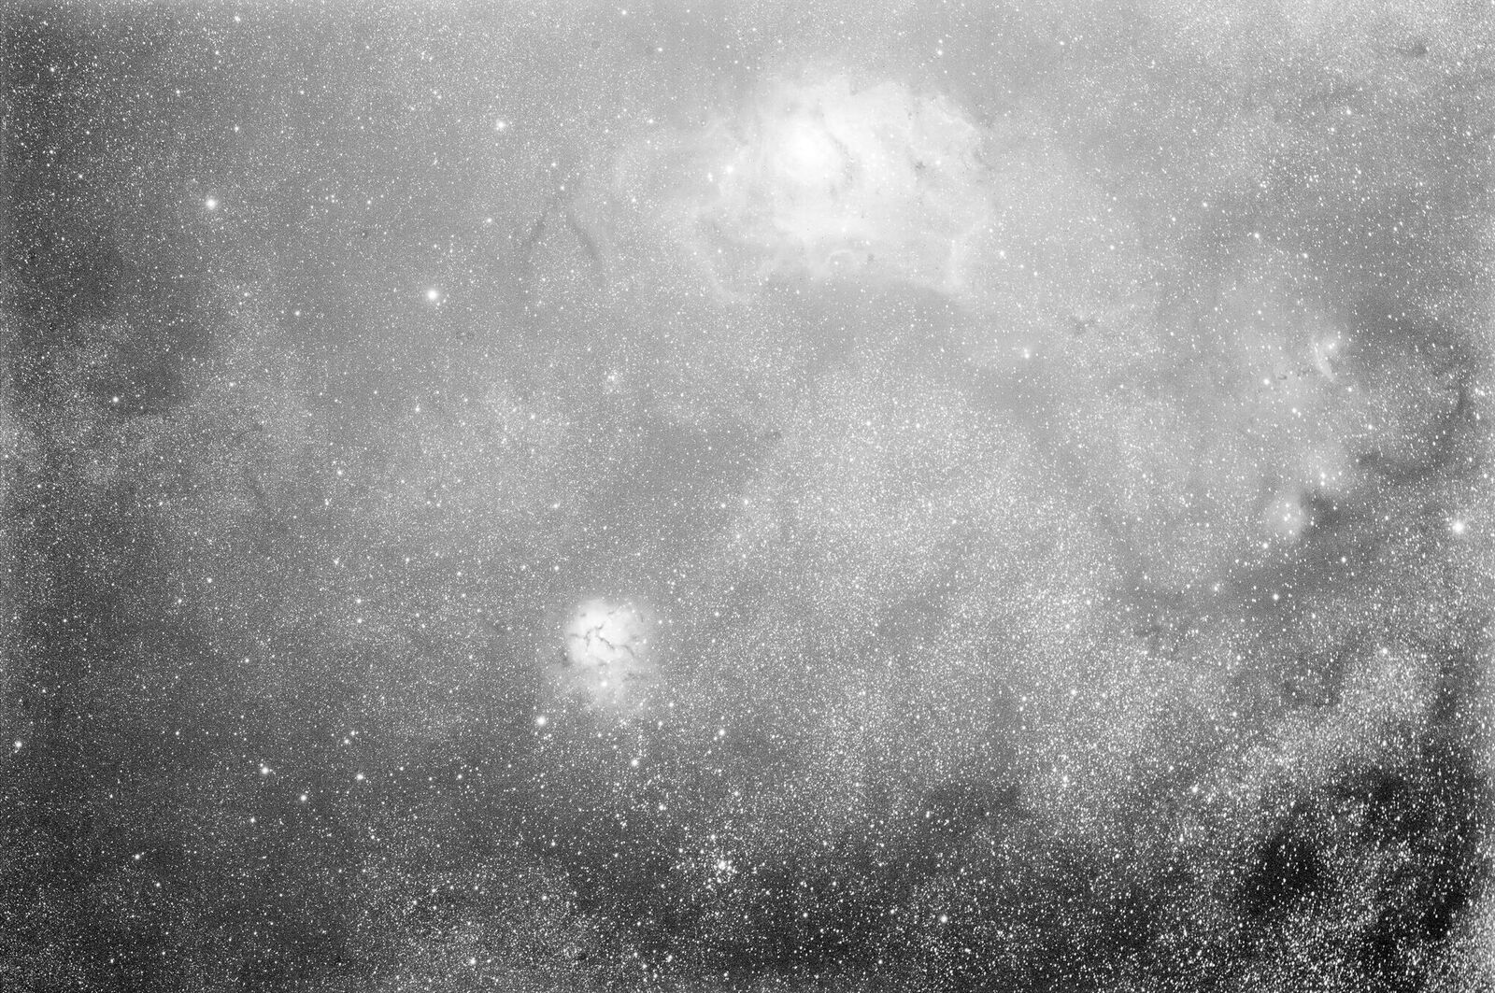
M8, M20, and M21
David Illig

Slide 21
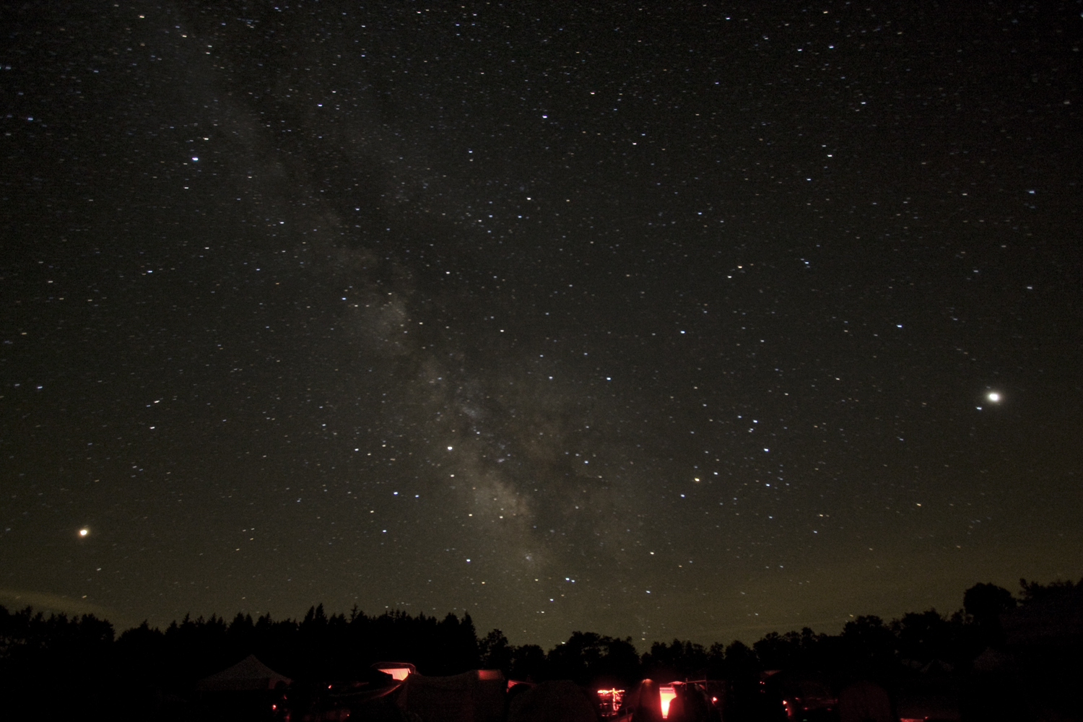
Member’s astrophotos
and sketches
The Milky Way, Mars, Saturn, and Jupiter
Cherry Springs Star Party, PA, June 2018
James Williinghan

Slide 22
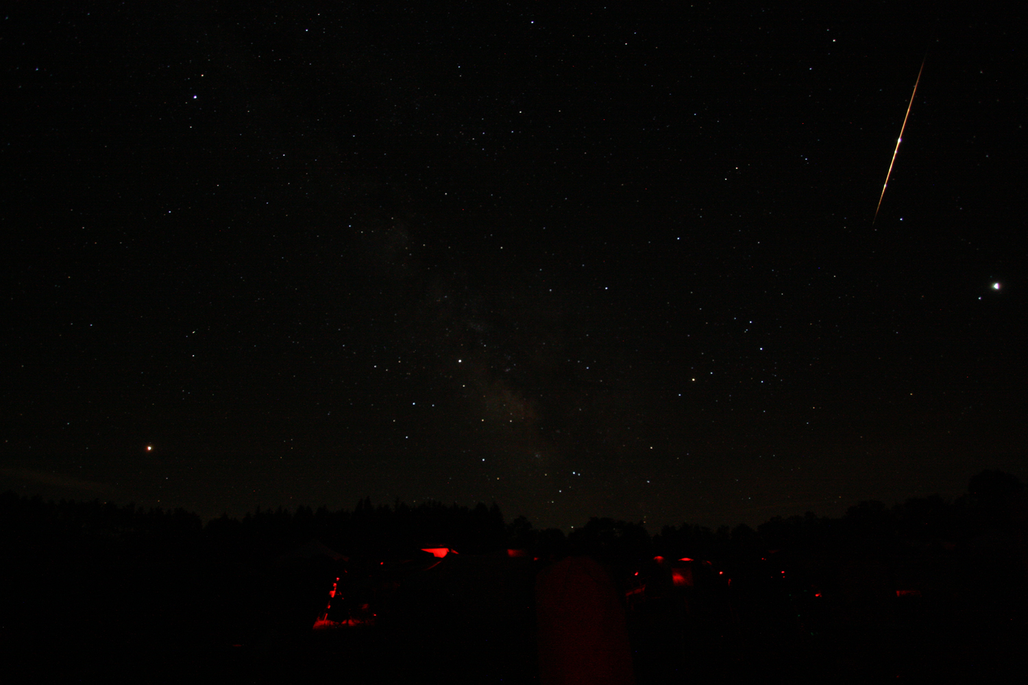
Bolide
Cherry Springs Star Party, PA, June 2018
James Willinghan

Slide 23
Thank You!
Next month’s meeting is on Thursday, July 19th 2018 at 7 PM
Lou Mayo
NASA, Sciences and Exploration Directorate
NASA Science Results from the August 21st 2017 Total Solar Eclipse

